Slide 1

Interviewing and Analysis
DFP ???
Intro to Qual 101

Slide 2
Schedule
1
What is Empathy?
2
Interviewing 101
3
The Art of the Interview
4
Analysis
5
Models
6
Workshop

Slide 3
Cognitive Empathy
What is empathy?
Emotional Empathy
Understanding what went on in someone’s head as they worked towards something
Feeling the same emotion that another person is feeling

Slide 4
Cognitive Empathy
What is empathy?
Emotional Empathy
Asking about the last time someone did something, and listening to the what, why, how, and when
That heart warming feeling when your friend gets married
Crying during a scene in a movie

Slide 5
Cognitive Empathy
What is empathy?
Emotional Empathy
Viable in work, specific, and replicable
Not reliably replicable, directs attention without thought

Slide 6
Building Cognitive Empathy
What is empathy?
We can build cognitive empathy by listening neutrally and holistically to our users.
One method to do so is the user interview.

Slide 7
Interviewing 101
Interviewing 101
Interviewing is not the same thing as talking.
Interviewing is a skill that requires deliberate and specific choices about what to say, how to say it, and when to say nothing.

Slide 8
Why Interview?
Interviewing 101
You aren’t your user
People who make a product and people who use a product think about it fundamentally differently
Tangible and grounded evidence
Interviewing gives insight from real people that can help your team prioritize project goals, establish expectations, and provide evidence to leadership of success or failure
Sync your team
Teams who share the experience of meeting their users are enlightened, aligned, and more empathetic

Slide 9
Why Interview?
Interviewing 101
You aren’t your user
People who make a product and people who use a product think about it fundamentally differently
Tangible and grounded evidence
Interviewing gives insight from real people that can help your team prioritize project goals, establish expectations, and provide evidence to leadership of success or failure
Sync your team
Teams who share the experience of meeting their users are enlightened, aligned, and more empathetic

Slide 10
Why Interview?
Interviewing 101
You aren’t your user
People who make a product and people who use a product think about it fundamentally differently
Tangible and grounded evidence
Interviewing gives insight from real people that can help your team prioritize project goals, establish expectations, and provide evidence to leadership of success or failure
Sync your team
Teams who share the experience of meeting their users are enlightened, aligned, and more empathetic

Slide 11
Basic Interview Guidelines
The art of the interview
Concepts supporting ethnographic research
Bad
Good
What to avoid:
Avoid a fixed set of questions.
Avoid making the user the designer
Avoid discussing technology
Avoid leading questions.
“Would feature X help you?”
“You like X, don’t you?”
“Do you think you’d use feature X if it were available?”
“Does X seem like a good idea to you?”
What to do:
Interview where the interaction happens.
Assume the role of an apprentice, not an expert.
Use open-ended and closed-ended questions to direct the discussion.
Focus on goals first and tasks second (Cooper Group Method).
Encourage storytelling.
Ask for a show-and-tell.
Use open ended questions to encourage detailed responses.
“Why” ”How” What”
“What makes a good day? A bad day?”
”How do you work around problems?”
“Why would that be a good solution?”
Use close ended questions to get back on track or shut down a topic.
“Did you…”
“Do you…”
”Would you…”
General Guidelines in Detail: About Face
In-depth Interviewing Planning: Designing for the Digital Age
In-depth Interviewing Execution: Observing the User Experience

Slide 12
General Tips
The art of the interview
Understand your user’s language.
Be neutral. Nothing is to be judged. Openness and trust flows from nonjudgmental rapport.
The best cue to encourage talking is nonverbal; just gently nod the head.
A sign that an interview is going poorly is when the interviewer is talking more than the interviewee.
Failure to understand a response from the interviewee should be clearly noted as a failure of the interviewer.
Take note of non-verbal cues, the environment, and the full context.

Slide 13
How to Ask Questions
The art of the interview
Never assume or ask leading questions.
Good questions should be open-ended, neutral, singular, and clear.
Don’t ask yes/no questions unless you are trying to end a rant.
Use “Tell me more” instead of “Why.”
Do your best to make every question singular, no more than one idea should be contained in any given question.
”you like pop music right?” X
”How did your morning begin?”
”Can you tell me more about that incident?”
”How well do you know and like the staff in this program” X
“How well do you know the staff?”
“How much do you like the staff?”

Slide 14
Types of Questions
The art of the interview
Gather context and collect details
Ask about sequence
Ask about quantity
Ask for specific examples
Ask about exceptions
Ask for complete lists
Ask about relationships
Ask about organizational structure
Probe what’s been unsaid
Ask for clarification
Ask about code words/native language
Ask about emotional cues
Probe delicately
Ask for an outsider explanation
Get a tutorial

Slide 15
1. Raw Interviews Contextual Analysis
Analysis
Raw Interview Data
“I think of sports events as social events, so I like to go with my friends. The problem is that we often have to sit in different places, so uh, it is not like as much as fun. I think it’d be cooler if we could you know like sit together.”
Tag all of your source data so it can be referenced moving forwards.
Note ID | User ID | Question | Notes | Comments
N1 | I-PV-1 | Can you tell me a little about yourself? | I’m a pretty young guy, I love sports you know. | Very outgoing, confident
N2 | I-PV-1 | When was the last time you went to a sporting event? | Hmm… not to long ago man. It was last week at the college game!

Slide 16
2. WANs Contextual Analysis
Analysis
Raw Interview Data
“I think of sports events as social events, so I like to go with my friends. The problem is that we often have to sit in different places, so uh, it is not like as much as fun. I think it’d be cooler if we could you know like sit together.”
Tag all of your source data so it can be referenced moving forwards.
Work Activity Note (WAN)
“When I am looking to buy student tickets to MU basketball, I look for an option allowing several friends to sig together.”
Paraphrase and synthesize the raw quote. Filter out noise.
Write from a work domain perspective (don’t start designing yet).
Tag your WANs.

Slide 17
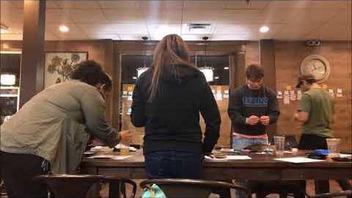
3. WAAD Contextual Analysis
Analysis
For how to construct a WAAD (Work Activity Affinity Diagram) reference the UX Book pg. 144

Slide 18

Using Behavioral Variables Goal-Directed
Analysis
Identify Your Variables
Activities- What the user does; frequency and volume
Attitudes- How the user thinks about the product domain
Aptitudes- What the education and training the user has
Motivations- Why the user is engaged in the product domain
Skills- User abilities related to the product domain
Map Your Interviewees to the Variables
Service-Oriented
Price-Oriented
I-PV-3
I-PV-2
I-PV-1,4,5
Necessity Only
Entertainment
I-PV-1, 4
I-PV-2, 5
I-PV-3

Slide 19
Using Behavioral Variables Goal-Directed
Analysis
Identify Trends
Capture Findings
Service-Oriented
Price-Oriented
I-PV-3
I-PV-2
I-PV-1,4,5
Necessity Only
Entertainment
I-PV-1, 4
Persona 1
I-PV-1, 4
I-PV-2, 5
I-PV-3
For the full Cooper Group Persona process, read Designing for the Digital Age

Slide 20
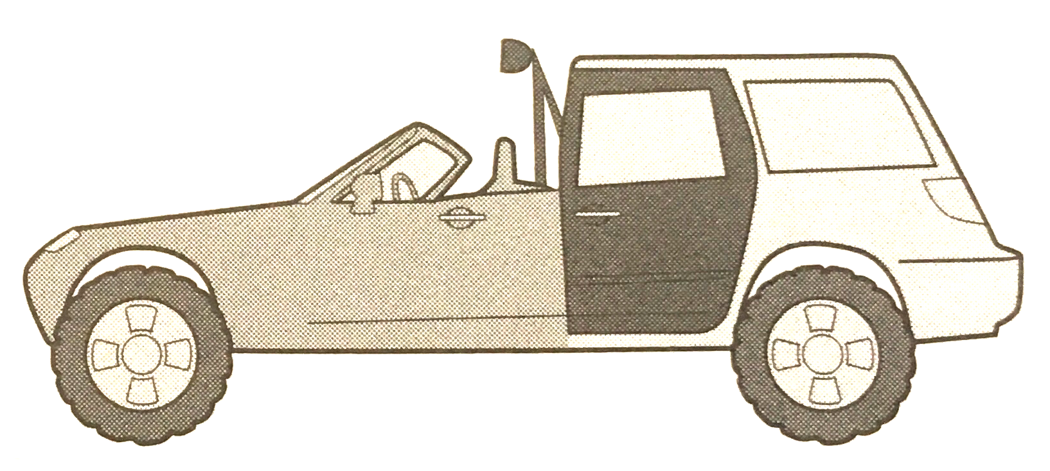
Personas Modeling Users
Design informing models
Good design has meaning only for someone who uses a product for a particular purpose.
Personas are based on research.
Based off of your research and interviews, behaviors can be assembled by related usage patterns. They are context-specific. They are not stereotypes.
Personas prevent design pitfalls.
Personas remedy a lack of precision about the user, prevent self-referential design and prevent designing for edge cases.
Personas ensure a focused design.
The best way to successfully accommodate a variety of users is to design for specific types of individuals with specific needs.
“If you try to design an automobile that pleases every possible driver, you end up with a car with every possible feature that pleases nobody.”
—Alan Cooper, About Face

Slide 21
Design informing models
Behavioral Patterns
Personas are a composite of key behaviors found in research. Synthesize characteristics related to these key behaviors to create your persona.
Identify Goals
What goals lead to the behavioral patterns identified? Infer these goals and tie them into your persona’s narrative.
Create a Narrative
Include enough detail to cover basic demographics and to weave behavior patterns into the story. The detail should not exceed the depth of your research.
Resources
Photos
http://www.exactitudes.com/
Process
Alan Cooper, About Face

Slide 22
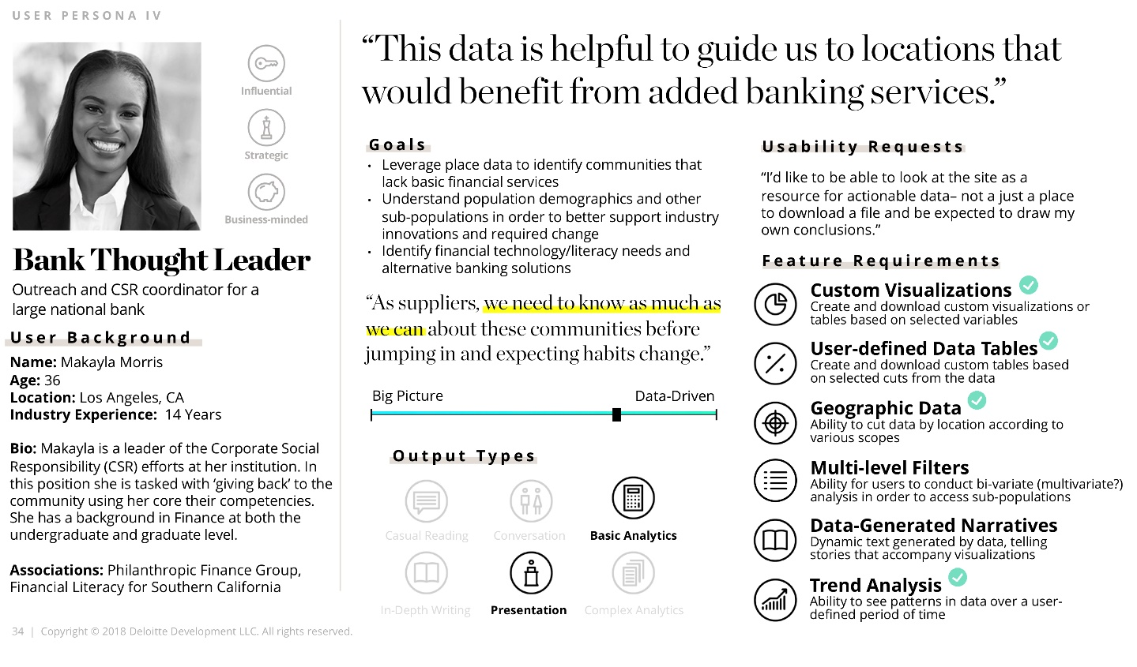
Personas Modeling Users
Design informing models
Behavioral Patterns
Personas are a composite of key behaviors found in research. Synthesize characteristics related to these key behaviors to create your persona.
Identify Goals
What goals lead to the behavioral patterns identified? Infer these goals and tie them into your persona’s narrative.
Create a Narrative
Include enough detail to cover basic demographics and to weave behavior patterns into the story. The detail should not exceed the depth of your research.
Resources
Photos: http://www.exactitudes.com/
Process: Alan Cooper, About Face

Slide 23
Workshop Prep
Workshop
Split up into groups with one Deloitte Digital lead each
Circle up and review your interview tips and question sheets

Slide 24
Workshop Prompt and Directions
workshop
Your goal is to figure out what we did over the winter holiday season.
In clockwise order, take turns asking 3 questions to the interviewee.
After every 3 questions, pause. If you did not ask questions, give feedback to the interviewer using your tips sheet.
After a short round of feedback, pass the role of interviewer to the next person and continue the interview!

Slide 25
Appendix

Slide 26
Interviewing Process in Design
Interviewing 101
Deeply studying people, ideally in their context
Exploring the meaning behind their behaviors
Making sense of the data using inference, interpretation, analysis, and synthesis
Using those insights to point toward a design, service, product, or solution

Slide 27
Ground Rules
The art of the interview
Check your worldview at the door
Don’t become invested in a particular outcome or expect any set of answers.
Embrace how other people see the world
Instead of asking people to come to you, go where they are. In order to embrace their world, you need to be in it. You will benefit by interviewing them in their own environment.
Be strategic when building rapport
Reach out ahead of the interview. Be selective about talking about yourself. Stay neutral. Reflect questions back to the user. Be aware of your body language.

Slide 28
Ground Rules
The art of the interview
Check your worldview at the door
Don’t become invested in a particular outcome or expect any set of answers.
Embrace how other people see the world
Instead of asking people to come to you, go where they are. In order to embrace their world, you need to be in it. You will benefit by interviewing them in their own environment.
Be strategic when building rapport
Reach out ahead of the interview. Be selective about talking about yourself. Stay neutral. Reflect questions back to the user. Be aware of your body language.

Slide 29
Ground Rules
The art of the interview
Check your worldview at the door
Don’t become invested in a particular outcome or expect any set of answers.
Embrace how other people see the world
Instead of asking people to come to you, go where they are. In order to embrace their world, you need to be in it. You will benefit by interviewing them in their own environment.
Be strategic when building rapport
Reach out ahead of the interview. Be selective about talking about yourself. Stay neutral. Reflect questions back to the user. Be aware of your body language.

